Slide 1
Open RAN
Dian Hanifudin Subhi

Slide 2
Outline
Weekly report
Summary of this week’s work
Your work
Conclusion
Your opinion/thought
Action item

Slide 3
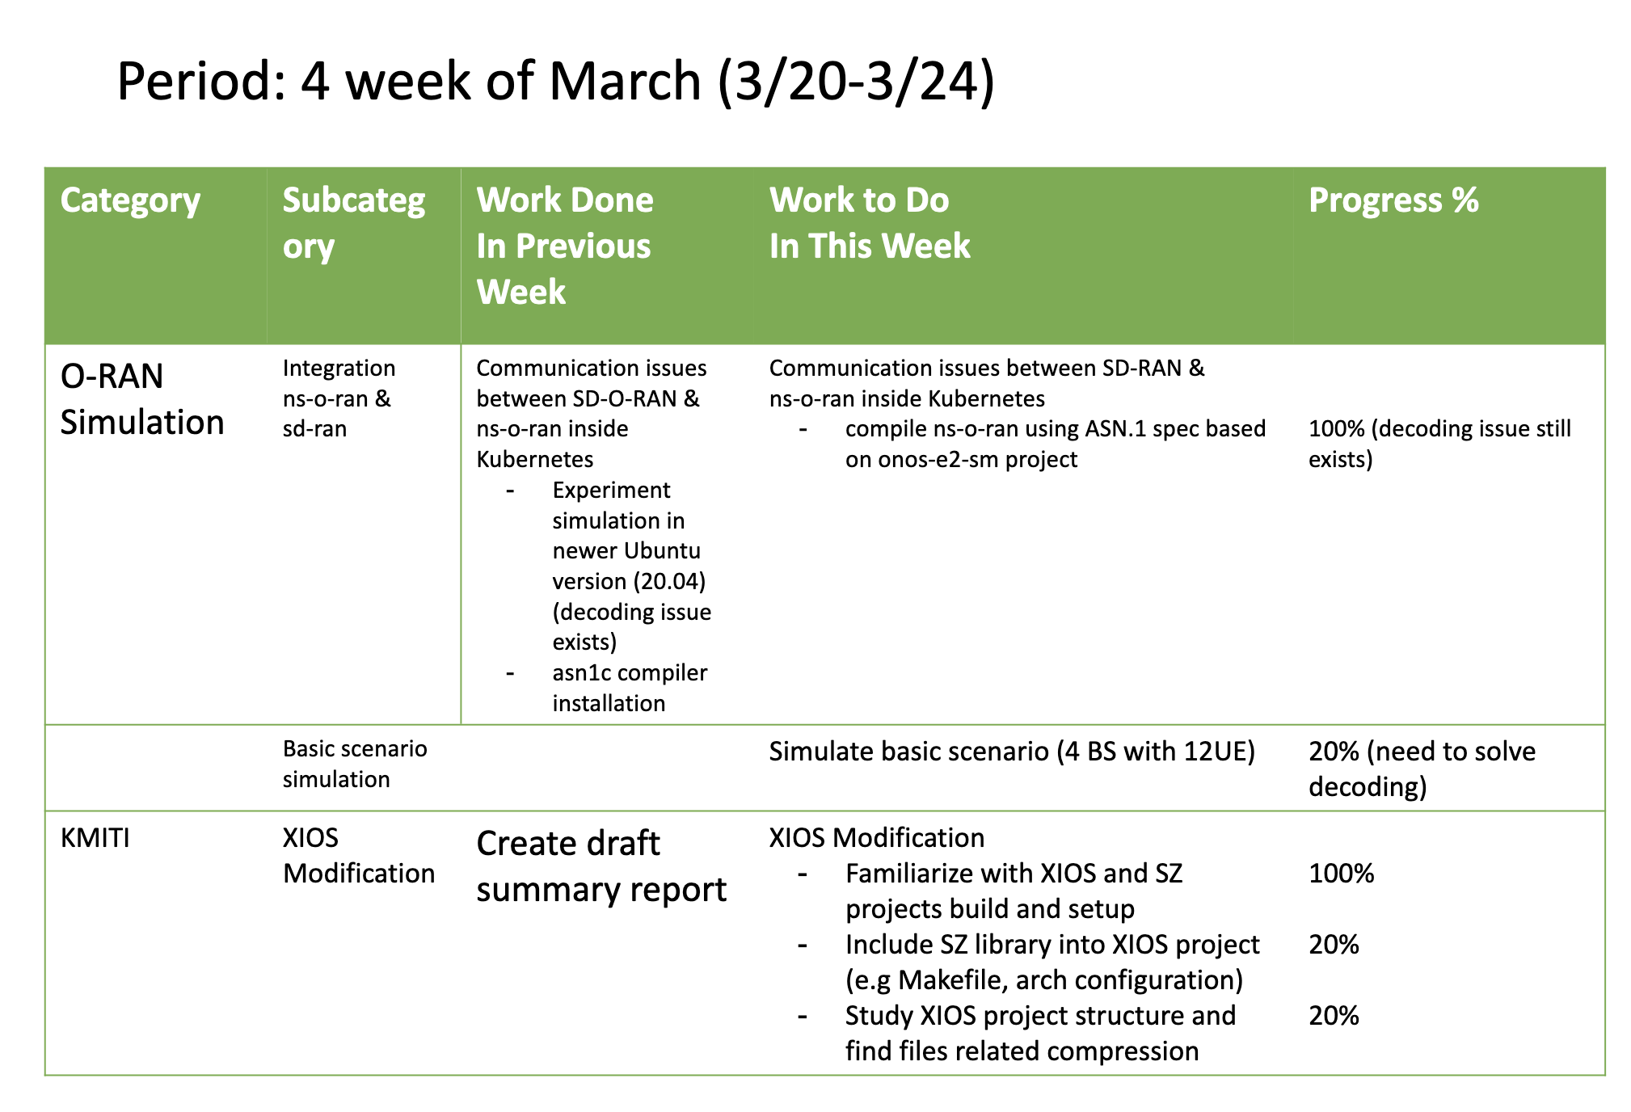
Weekly report

Slide 4
Summary of work this week
Troubleshooting decoding and trying simulation with basic scenario
Study about XIOS modification related to SZ compression

Slide 5
Question to be Answered
How is the progress of ns3 integration with SD-RAN?
What modification is needed to apply SZ compression?

Slide 6
ns3 integration
Compiling KPM one of E2SM
Compiling e2sim using new KPM is successful but the decoding issue still exist when decoded the message

Slide 7
SZ setup
SZ setup
git clone https://github.com/szcompressor/SZ
cd SZ
./configure --enable-fortran
make
sudo make install

Slide 8
XIOS setup
XIOS setup
Setup reference: https://nemo-related.readthedocs.io/en/latest/compilation_notes/nemo37.html
svn checkout http://forge.ipsl.jussieu.fr/ioserver/svn/XIOS/branchs/xios-2.0 xios-2.0
cd xios2.0/arch
cp arch-GCC_LINUX.env arch-GCC_local.env
cp arch-GCC_LINUX.fcm arch-GCC_local.fcm
cp arch-GCC_LINUX.path arch-GCC_local.path

Slide 9
XIOS setup
Adjust arch-GCC_local.env
# old config
export HDF5_INC_DIR=$HOME/hdf5/hdf5/include
export HDF5_LIB_DIR=$HOME/hdf5/hdf5/lib
export NETCDF_INC_DIR=$HOME/netcdf4/include
export NETCDF_LIB_DIR=$HOME/netcdf4/lib
export BOOST_INC_DIR=$HOME/boost
export BOOST_LIB_DIR=$HOME/boost
# new config
export HDF5_INC_DIR=$HOME/hdf5/hdf5/include
export HDF5_LIB_DIR=$HOME/hdf5/hdf5/lib
export NETCDF_INC_DIR=$HOME/netcdf4/include
export NETCDF_LIB_DIR=$HOME/netcdf4/lib
export BOOST_INC_DIR=$HOME/boost
export BOOST_LIB_DIR=$HOME/boost

Slide 10
XIOS setup
Running make_xios
XIOS provided make_xios script to generate Makefile and download dependencies based on the flag argument.
Run make_xios script
./make_xios --full --prod --arch GCC_local -j2 |& tee compile_log.txt

Slide 11
Link SZ into XIOS
Modify CFLAGS
SZ library prefix installed on /usr/local
Add variable inside the arch-GCC_lorcal.env related with SZ library
# new config
export HDF5_INC_DIR=/usr/local/include
export HDF5_LIB_DIR=/usr/local/lib
export NETCDF_INC_DIR=/usr/local/include
export NETCDF_LIB_DIR=/usr/local/lib
export BOOST_INC_DIR=/usr/local/include
export BOOST_LIB_DIR=/usr/local/lib
export SZ_INC_DIR=/usr/local/include
export SZ_LIB_DIR=/usr/local/lib

Slide 12
Link SZ into XIOS
Modify CFLAGS
Add additional variable inside arch-GCC_local.path
Add flag to linked SZ library -lSZ
NETCDF_INCDIR="-I $NETCDF_INC_DIR"
NETCDF_LIBDIR="-L $NETCDF_LIB_DIR"
NETCDF_LIB="-lnetcdff -lnetcdf"
MPI_INCDIR=""
MPI_LIBDIR=""
MPI_LIB="-lcurl"
HDF5_INCDIR="-I $HDF5_INC_DIR"
HDF5_LIBDIR="-L $HDF5_LIB_DIR"
HDF5_LIB="-lhdf5_hl -lhdf5 -lhdf5 -lz"
BOOST_INCDIR="-I $BOOST_INC_DIR"
BOOST_LIBDIR="-L $BOOST_LIB_DIR"
BOOST_LIB="”
SZ_INCDIR=“-I $SZ_INC_DIR”
SZ_LIBDIR=“-L $SZ_LIB_DIR”
SZ_LIB=“-lSZ”
OASIS_INCDIR="-I$PWD/../../oasis3-mct/BLD/build/lib/psmile.MPI1"
OASIS_LIBDIR="-L$PWD/../../oasis3-mct/BLD/lib"
OASIS_LIB="-lpsmile.MPI1 -lscrip -lmct -lmpeu"

Slide 13
Link SZ into XIOS
Modify CFLAGS
add SZ header file into nc4_data_output.hpp
#include “sz.h”
Rerun make_xios to get new Makefile
./make_xios --full --prod --arch GCC_local -j2 |& tee compile_log.txt

Slide 14
Link SZ into XIOS
mpicc -o nc4_data_input.o -DUSING_NETCDF_PAR -I/home/dhs/Workspaces/hpclab/kmiti/xios/inc -ansi -w -O3 -DBOOST_DISABLE_ASSERTS -I /usr/local/include -I /usr/local/include -I/home/dhs/Workspaces/hpclab/kmiti/xios/extern/boost -I/home/dhs/Workspaces/hpclab/kmiti/xios/extern/blitz -I /usr/local/include -I/home/dhs/Workspaces/hpclab/kmiti/xios/extern/src_netcdf4 -I/home/dhs/Workspaces/hpclab/kmiti/xios/extern/boost/include -I/home/dhs/Workspaces/hpclab/kmiti/xios/extern/rapidxml/include -I/home/dhs/Workspaces/hpclab/kmiti/xios/extern/blitz/include -c /home/dhs/Workspaces/hpclab/kmiti/xios/src/data_input.cpp
touch /home/dhs/Workspaces/hpclab/kmiti/xios/flags/CFLAGS__xios__nc4_data_output.flags
touch /home/dhs/Workspaces/hpclab/kmiti/xios/flags/CPPKEYS__xios__nc4_data_output.flags
gmake: *** No rule to make target 'sz.h', needed by ‘nc4_data_output.o'. Stop.
gmake -f /home/dhs/Workspaces/hpclab/kmiti/xios/Makefile -j 1 all failed (2) at /home/dhs/Workspaces/hpclab/kmiti/xios/tools/FCM/bin/../lib/Fcm/Build.pm line 597.
Build failed on Thu Mar 23 03:49:12 2023.
->Make: 74 seconds
->TOTAL: 78 seconds
Monitor log_compile.txt
No rule to make target ‘sz.h’, needed by `nc4_data_output.o’
It’s means the generated of Makefile still wrong, because the compiler can’t recognize the SZ header file

Slide 15
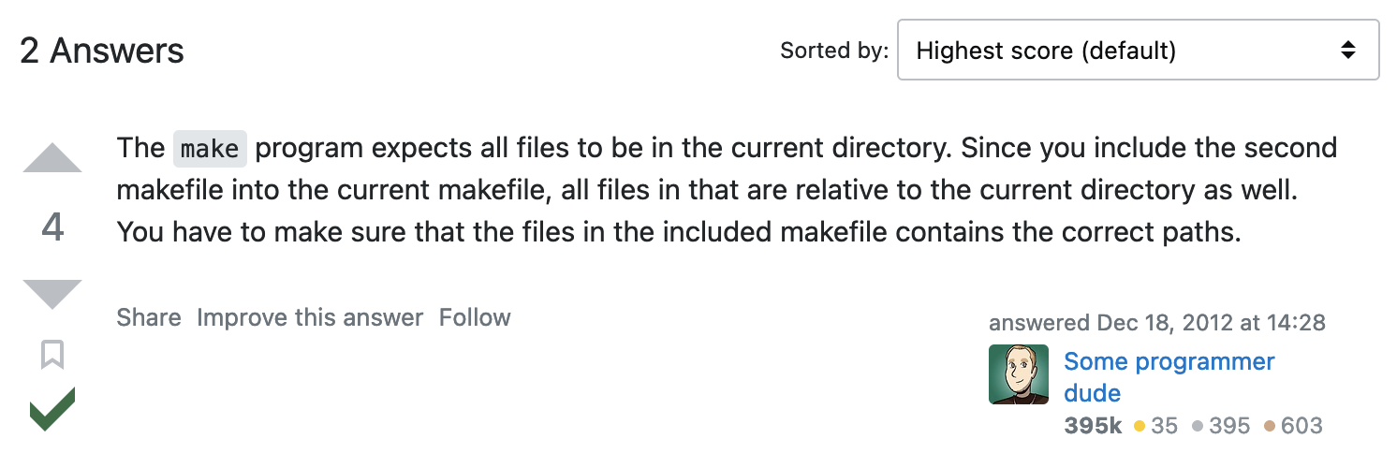
Link SZ into XIOS
Troubleshooting
Clone the SZ project into XIOS/extern/SZ
Remodify arch-GCC_local.env, then replace /usr/local/include with ${PWD}/extern/SZ
But the compilation error still exist because the compiler can’t recognize SZ library

Slide 16
Link SZ into XIOS
Troubleshooting
Include SZ header file using absolute path
#include ”/usr/local/include/sz.h”
Rerun make_xios script again
The compilation script is error, but the compiler can recognize the SZ library
fcm_internal load:F zzz server_main.o xios_server.exe
ar: creating /home/dhs/xios-2.0_clena/tmp/lib__fcm__xios_server.a
mpif90 -o xios_server.exe /home/dhs/xios-2.0_clena/obj/server_main.o -L/home/dhs/xios-2.0_clena/lib -l__fcm__xios_server -Wl,'--allow-multiple-definition' -L /lib -L /lib -L /lib -L /lib -lnetcdff -lnetcdf -lhdf5_hl -lhdf5 -lhdf5 -lz -lmpi -lstdc++
/usr/bin/ld: cannot find -lnetcdff
/usr/bin/ld: cannot find -lhdf5_hl
/usr/bin/ld: cannot find -lhdf5
/usr/bin/ld: cannot find -lhdf5
collect2: error: ld returned 1 exit status
fcm_internal load failed (256)
/home/dhs/xios-2.0_clena/Makefile:7902: recipe for target 'xios_server.exe' failed
gmake: *** [xios_server.exe] Error 1
gmake -f /home/dhs/xios-2.0_clena/Makefile -j 1 all failed (2) at /home/dhs/xios-2.0_clena/tools/FCM/bin/../lib/Fcm/Build.pm line 597.
Build failed on Thu Mar 23 08:32:16 2023.
->Make: 872 seconds
->TOTAL: 876 seconds

Slide 17
XIOS modification
Find related function to output
NEMO using netcdf4 as output format
The file of XIOS project related netcdf4 is nc4_data_output.hpp and nc4_data_output.cpp
Grep nc4_data_output.hpp with keyword: write, compress, deflate

Slide 18
Conclusion
Decoding issue still occurred when decode the message
SZ linked to XIOS project using absolute path
Understanding about the logic inside nc4_data_output.hpp and nc4_data_output.ccp is mandatory to implement SZ compression.

Slide 19
Your opinion/thought
Grep with keyword of write/compress inside XIOS is needed
Find similar project related with the implementation of SZ compression

Slide 20
Action items
Further action and direction based on Professor decision.

